Slide 1
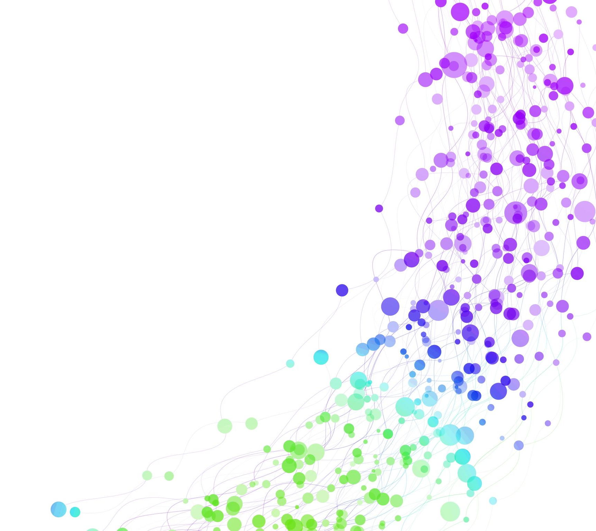
Moviester
Brad Shulman
Shahaf Dan
Shunshuke Ishida
Bing Zeng
Glenn Ee
Myriam Bengoechea

Slide 2


Overview
Our project utilizes two APIs: Twitter and IMDB
The user inputs a movie title and receives a “sentiment score” from IMDB and Twitter
The application uses Google authentication
A user’s search history is kept in a centralized database

Slide 3
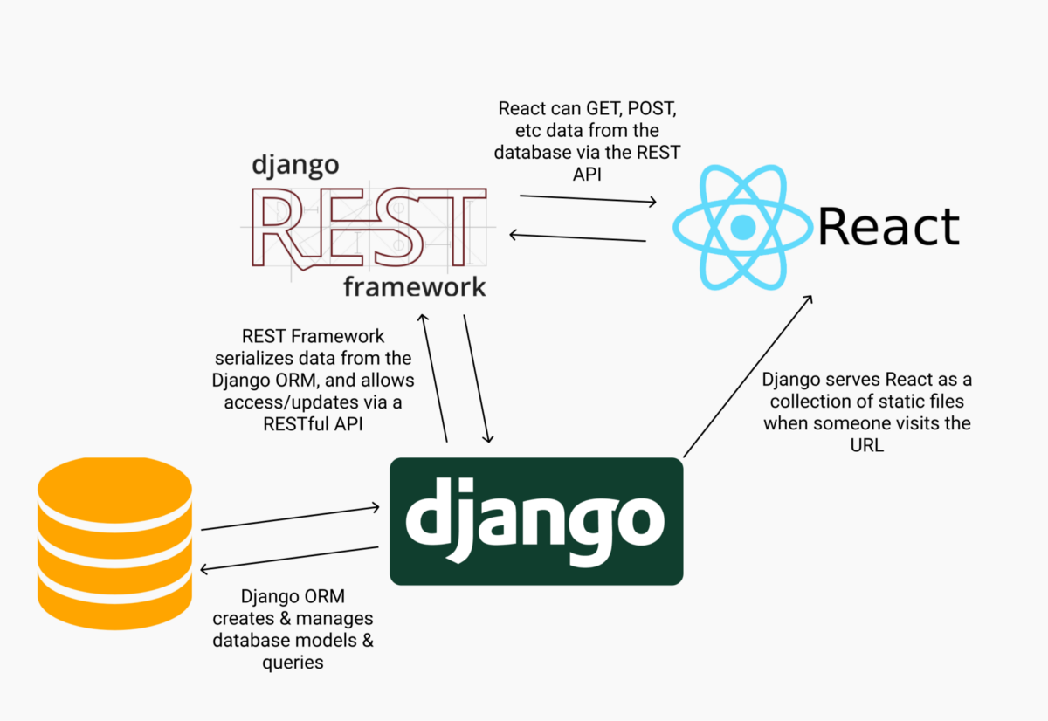
Web Flow Design
Back end
Framework: Django
Language: Python
Front end:
Framework: React
Language: Javascript

Slide 4
Workflow
To start the coding of the project, we initially split into three groups focused on:
Google Authentication
Front end
Back end
We maintained constant communication to ensure seamless integration
Each group largely worked separately, merged at the end

Slide 5
Let’s try it
*Your Local Host Link*

